Slide 1
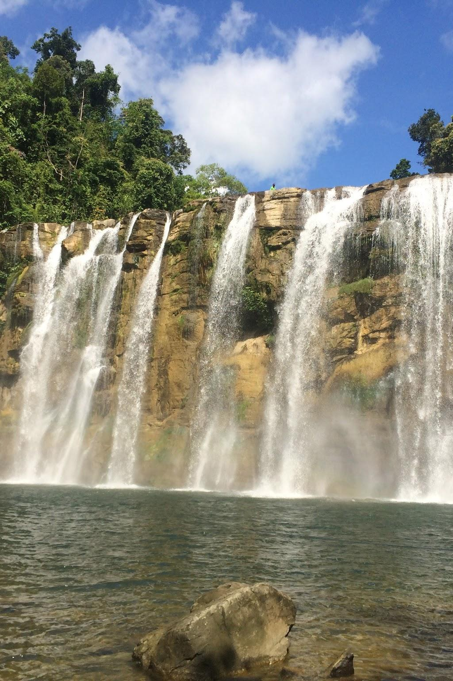
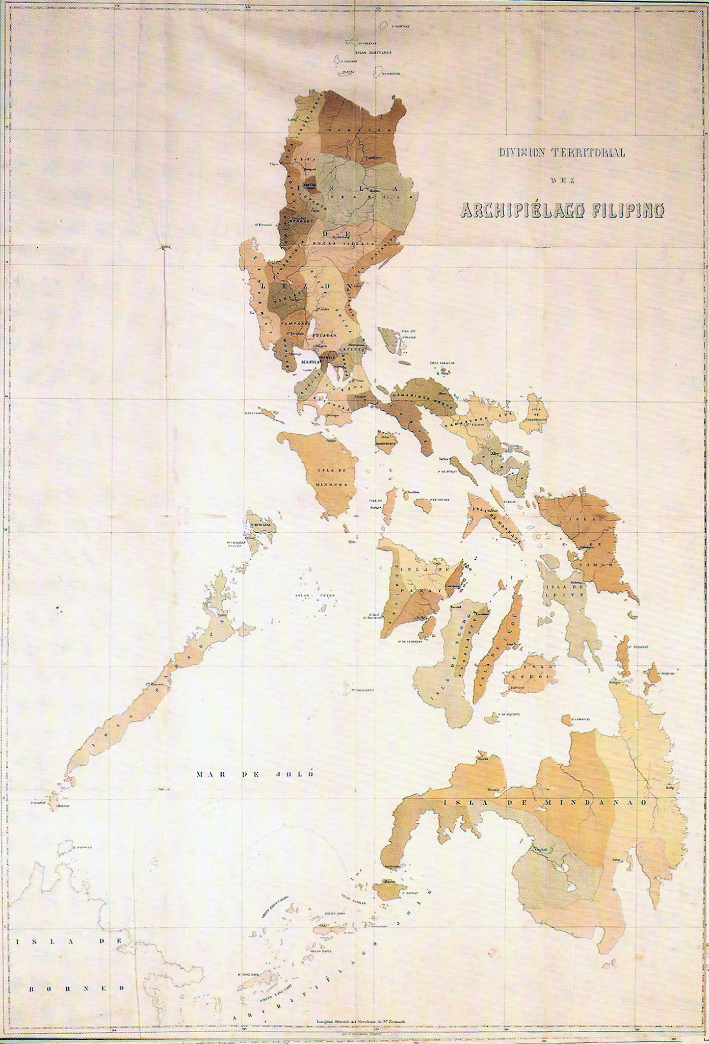
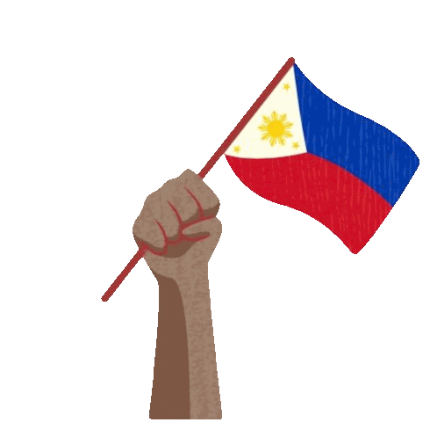
PHILIPPINES
Here is where your presentation begins

Slide 2

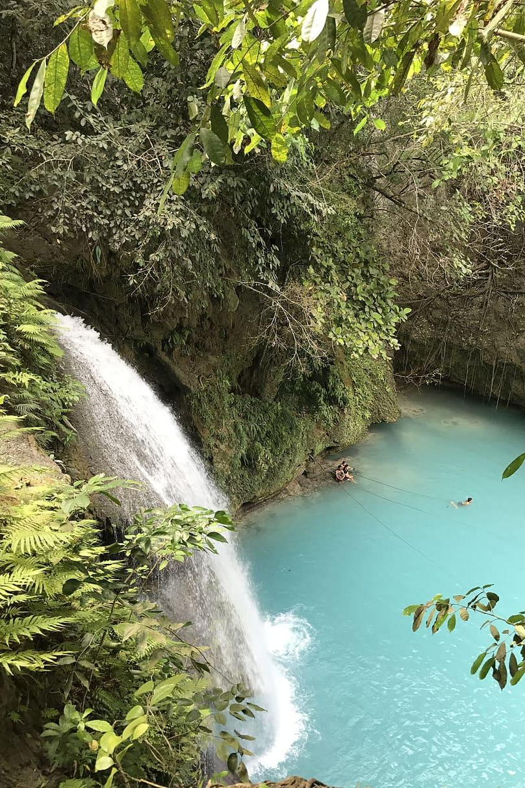
Philippines Introduction
The philippines is a group of islands in southeast asia . Philippines is divided into 18 regions. The climate is normally high temperature, high humidity and abundant rainfall. The climate of the country can be divided into two major seasons: First, the rainy season, from June to November; and 2nd the dry season, from December to May. The dry season may be subdivided further into a the cool dry season, from December to February, and the hot dry season, from March to May.
The Filipino people have a distinct Asian background, with a big Western tradition. The modern Filipino culture developed through influence from Chinese traders, Spanish conquistadors, and American rulers. The Philippines has an estimated population of over 117 million people. The philippines culture is to have a strong family bonds, deep religious faith, and community unity. More than 80% of the population of the Philippines is Roman Catholic. Life in the Philippines generally revolves around the extended family, including parents, grandparents, aunts, uncles, cousins and other relatives.
Filipino (the national language based on Tagalog) and English. Over 170 distinct regional languages and dialects exist. For its government type, it a presidential, representative, and democratic republic. This means that the Philippines has a president that was voted, representatives that go to the capital and vote laws for them, and democratic republic which means that the public rule through voting., The current leaders of the Philippines are President Bongbong Marcos, Vice President Sara Duterte, and House Speaker Faustino “Bojie” Dy III. They are the Political leaders of the Philippines.

Slide 3
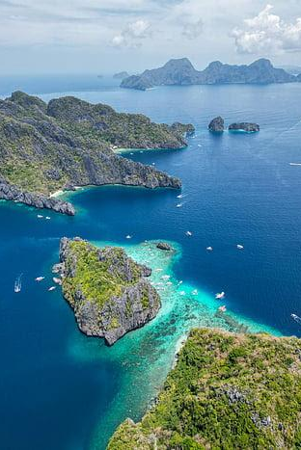
Philippines Issue
Natural Disasters & Climate Resilience is a huge problem within Philippines. Philippines is highly vulnerable to typhoons,monsoon rain, sea-level rise, and persistent flooding. The Philippines is among the countries with the greatest exposure to natural disaster risk worldwide.
The philippines is located in the western Pacific Ocean( Most tropical cyclone region on earth), it’s surrounded by warm waters that are getting warmer as sea temperatures rise. It’s also located in the ring of fire and the typhoon belt, it which creates more earthquakes, typhoons, and volcanic eruptions. These are the most common disasters in the Philippines.
Since the Philippines is an archipelago, it lacks a natural barriers between the islands and the sea. The role geography plays is that the philippines has tectonic island arcs, (The country is located on boundary of major tectonic plates), Narrow coastal plains, and it being lined by coral reefs, seagrass meadows, and mangrove forests. Which contribute to why these disasters are happening.

Slide 4
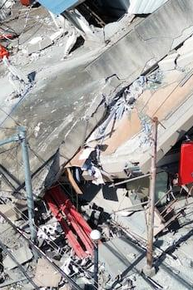
Something recent
On june 8th, there was an earthquake that killed 32 people. A powerful 7.8 magnitude earthquake struck the southern coast of Mindanao, Philippines. Dozens of people have been injured and triggered tsunami warnings across several ‌countries.

Slide 5
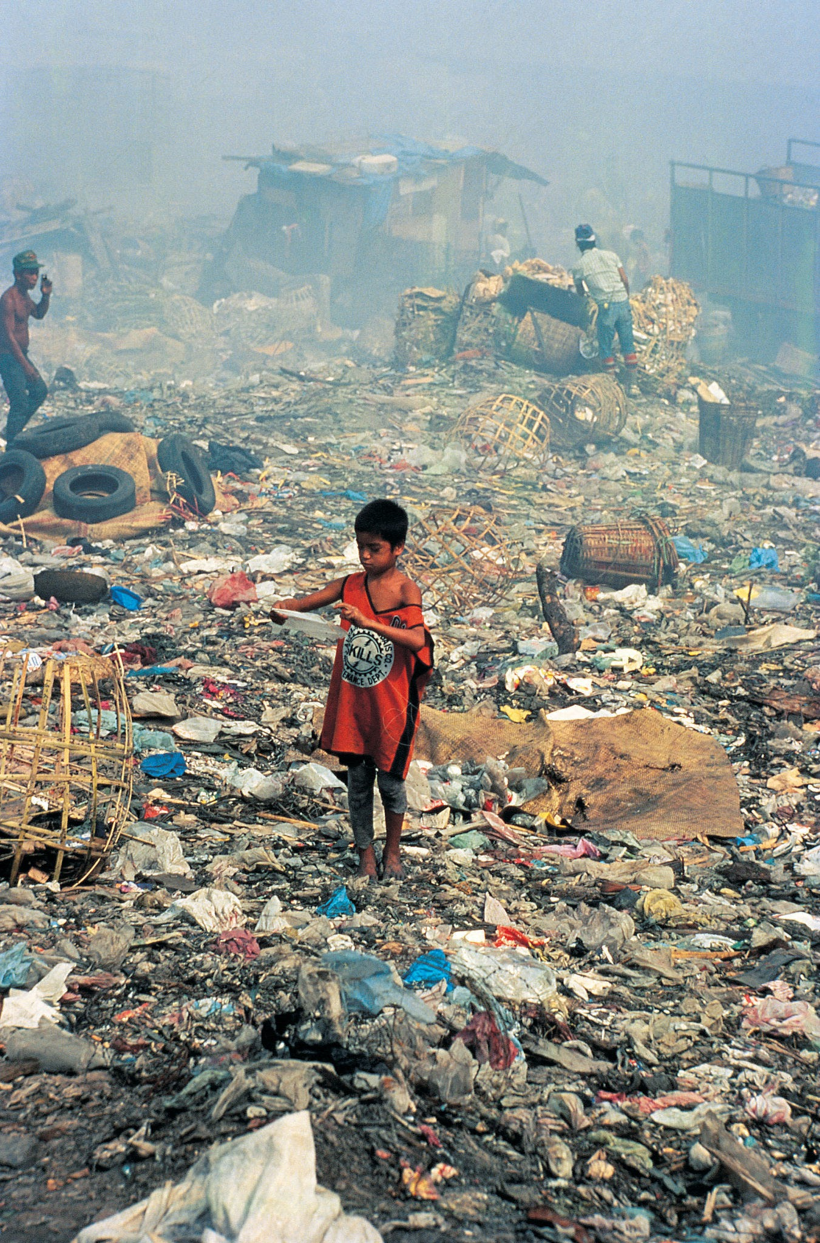


How is it affecting the world?
This issue matters globally because of how it’s affecting the environment, and the collective that lives there. The Philippines natural resources are endangered and many lives are at risk. Canadians and other people around the world should care and take climate action to help the Philippines reach a better, more sustainable future.
The top causes of climate change is greenhouse emissions from energy, deforation and land use changes, agricultural practices, an increase in extreme weather events, sea-level rise, and biodiversity loss. The Philippines is the 24th highest methane-emitting country, which makes it a huge contributor to global climate change.
Sea levels in the Philippines are rising more than the average global sea level rise. Philippines rises at a rate of 5.7-7 per year, while the average is 3.6mm. This causes coral reefs, coastal ecosystems and coastal communities to be at risk. The Philippines is a huge biodiversity hotspot, by it providing between 70%- 80% of the plant and animal species. So they are also endangered.

Slide 6
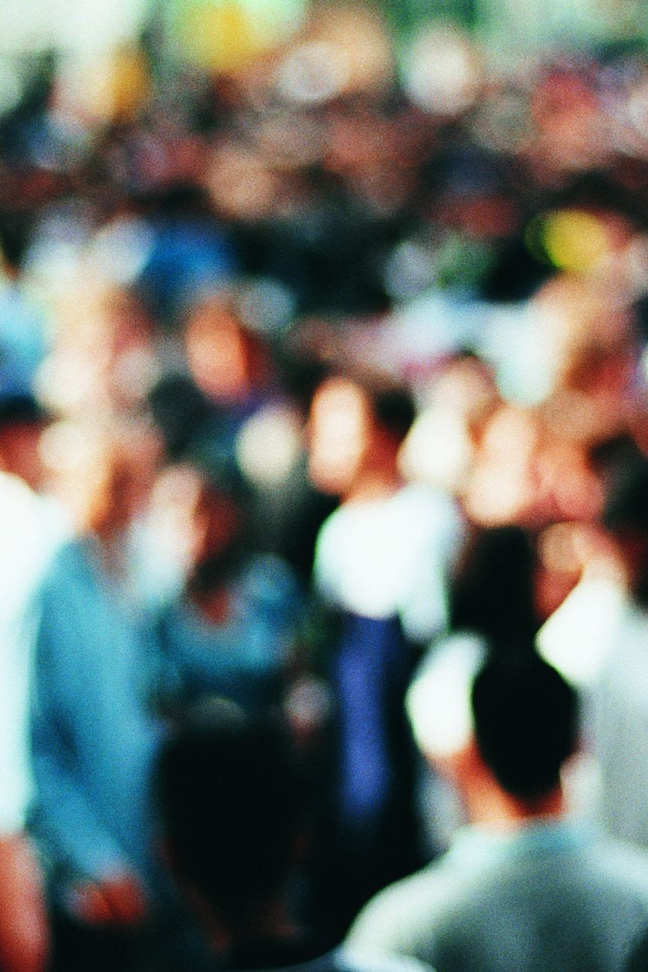
How is it affecting people?
Peoples health are getting affected. Many have experiences heat-related illnesses and deaths. The economic growth and food security is also at vulnerable.
Agriculture employs 23% of the workforce. Ever since the 2024 Typhoon Enteng, it had suffered 39 Million in damage. Fisheries have also been impacted by the oceans warming. The catch potential has now gone down by 24%. Tourism has also gone down from all of the natural disasters, which has caused the country's gdp (Gross Domestic Product) to go down.
People in the country are also getting blamed for these floods. People say because of factors like clogging waterways, those who live along riverbanks, and much more, the floods are caused by the citizens lack of discipline. In reality, it’s how politicians and contractors stole money from fake flood control projects. This resulted in prompting a public protest. If some people survive these disasters, they could also deal with much stress, and be in bad condition.

Slide 7
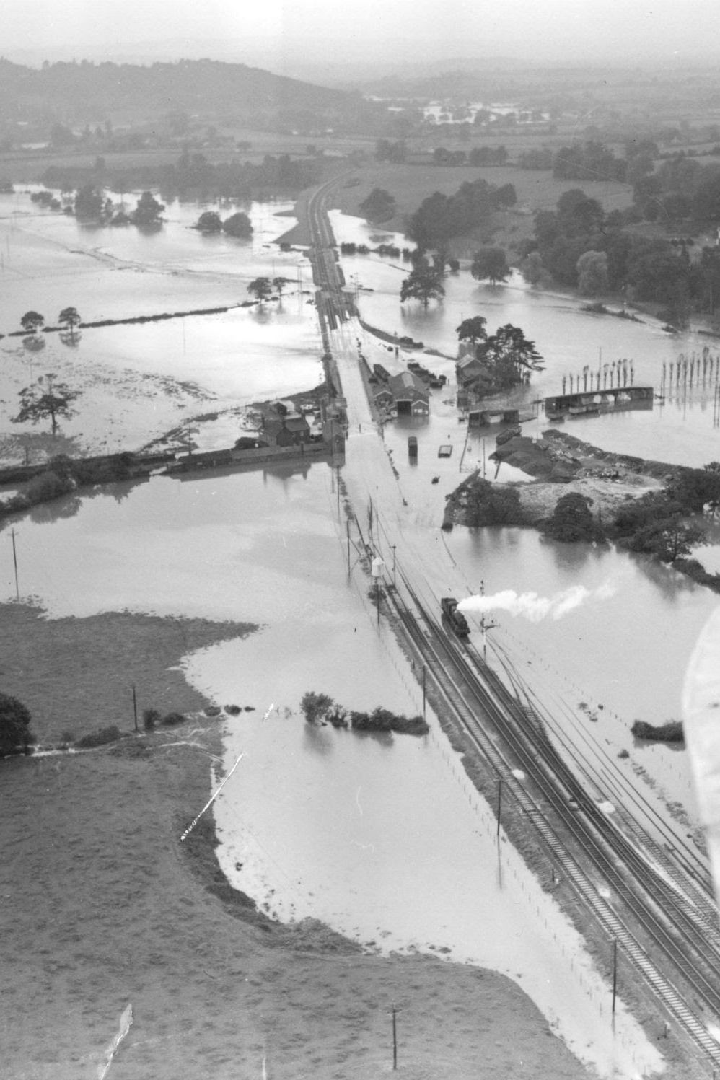
Action
The Philippines has planned out and tried to reduce the effects of natural disasters by giving better and improved warning systems for storms and floods. Some evacuation centers have been built, training rescue teams for people, and having drills to prepare for disaster.
The government has also created laws and plans for managing disasters, upgraded flood control projects, built stronger infrastructure, relocated people from dangerous areas, restored forests and mangroves, create a emergency bill to buy food and protect their home before disasters, give help/aid and support to communities affected by disasters.
This helps protect people and reduce damage when disasters happen. Studies show that these actions showed improvement in household food security. The evacuations have been successful, The amount of deaths has been lowered, and the drills have been effective.

Slide 8
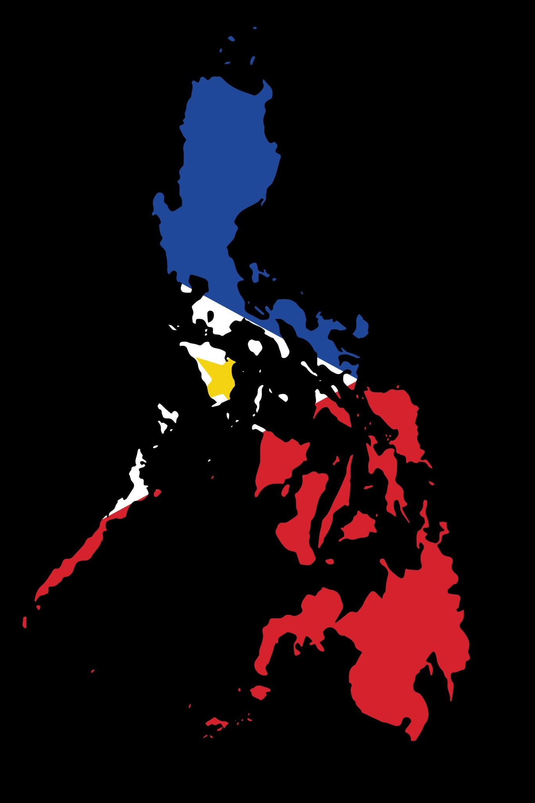
Programs
Projects such as Declaration of State of Imminent Disaster Act (RA 12287) is a emergency cash transfer that is given to protect families ahead of a crisis. Another law is DIsaster risk reduction and management act (DRRM) which tries to plan ahead and prepare before disasters happen, rather than responding after one. It’s a law which transforms the Philippines’ disaster management system from disaster relief and response towards disaster risk reduction (DRR). Multi-Hazard impact-based Forecasting, which sets up early warning systems so communities are safer before disasters hit.
The Philippine Atmospheric, Geophysical and Astronomical Services Administration (DOST-PAGASA) is a service which delivers weather related information, products and services to help and develop communities resilient to these natural disasters. The National Disaster Risk Reduction and Management Council (NDRRMC) Is a national act that prepares for disasters, has protocols to be prepared, and tries to reduce community vulnerabilities .Its the Philippines primary disaster management.
They have also launched the National Adaptation plan which is targeted to help countries with climate change. Disaster risk management (DRM), and Department of Public works and Highways (DPWH) are trying to make building safer. There have been meetings with 100 technical experts, government officials representatives and more.. This is so builds are more stable.

Slide 9
Consequences
Short term effects:
-Loss of lives and injuries.
-evicting families and communities.
-a pause in education due to damaged schools.
-Increased health risks from contaminated water and overcrowded evacuation centers.
-Damage to homes, businesses, roads, and bridges.
-Loss of income for farmers, fishers, and workers.
-Increased government spending on emergency relief and recovery.
-Soil erosion and landslides.
-Destruction of forests, coral reefs, and coastal ecosystems.
-Water contamination from flooding
Long term effects:
-Long-term displacement and migration.
-Mental health impact on people
-Increased poverty and inequality.
-Slower economic growth in some areas.
-Farms growing less food than before.
-High reconstruction costs.
-Loss of biodiversity.
-The coastal breaking down which causes more danger to future disasters
-Changes in ecosystems and natural resources.

Slide 10
Consequences
Who Benefits? Who suffers?
Before the land is destroyed corporations and property developers make lots of money by building big beachfront hotels, fancy houses, and ports for large ships. Before the land is gone, they sell it for money.
Tourist businesses also make money from travelers who come to visit. But this causes big problems for the regular people who actually live there. Local families lose their homes when the land washes into the sea, and local fishers lose their jobs because the fish have nowhere left to live.They need to pay to fix the damage and the future generations might start to live on bad land.
Unintended Consequences:
None of these disasters are intended. Beaches and cliffs start to crumble into the sea from erosion. When coastal trees and reefs are cut down, that means the barriers are gonna stop big storm waves from rushing much farther in land and cause worse flooding.
This also ruins the areas where fish live and lay eggs, so the fish eggs are destroyed. The salty ocean water pushes into the ground, which ruins the clean freshwater that local people need for drinking and farming.

Slide 11
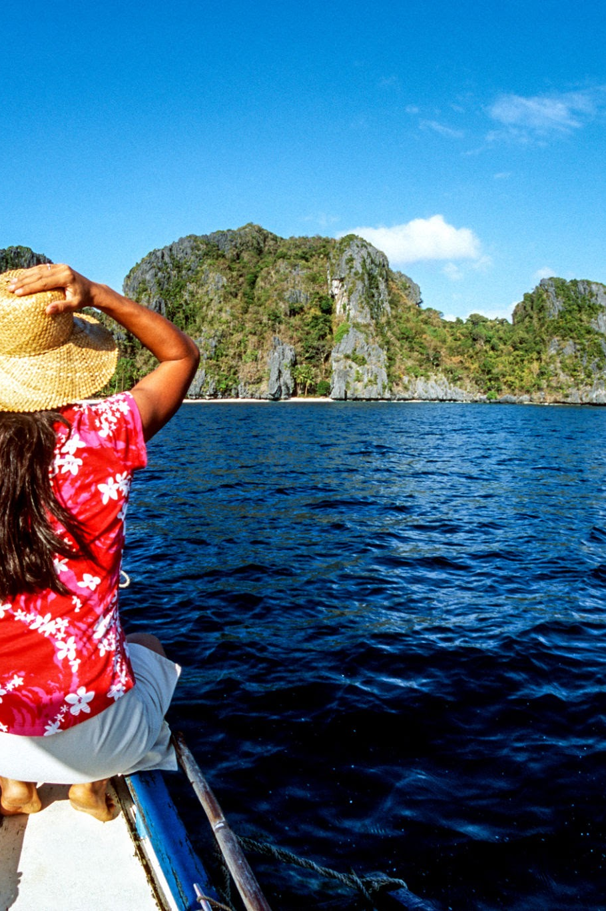

Canada Comparison
Canada’s Climate compared to the philippines is pretty different. Canada has 4 seasons, while the Philippines is normally hot and humid all year round. It’s only divided into wet and dry seasons. For Canada, the Winter temperature is normally around -10C, and in summer the temperature it often reaches 20C to 30C. Canada’s response to natural disasters, uses The Federally Identified Flood Risk Areas (FIFRA) , and Community Risk Index (CRI) .
The FIFRA help increase flood resilience across Canada by providing Canada-wide flood hazard information. The CRI is a data product that visualizes and communicates community-level flood risk for all of Canada. The Canadian government is creating an affordable national flood insurance program for high-risk homes. There is also something called Canada Structures, which is a government database that maps where buildings are to find out which ones are in danger of disasters like floods and wildfires.
Provincial and territorial governments have responsibility for emergency management within their respective jurisdictions. Most disasters happen locally, so the province handle it. If a disaster gets too big for a province to handle and they need more resources,, the federal government can provide extra help. When they ask the federal government for help, it can include CAF personnel, equipment, and facilities when required and available. When the CAF responds to such a crisis, it is known as Operation LENTUS. Operation LENTUS is the Canadian Armed Forces (CAF) response to natural disasters in Canada.
The Canadian Red Cross is at the scene of disasters and emergencies both at home and around the world. Red Cross and Salvation Army provide food and shelter. Canada also uses the Disaster Assistance Response Team (DART) to help other countries!

Slide 12
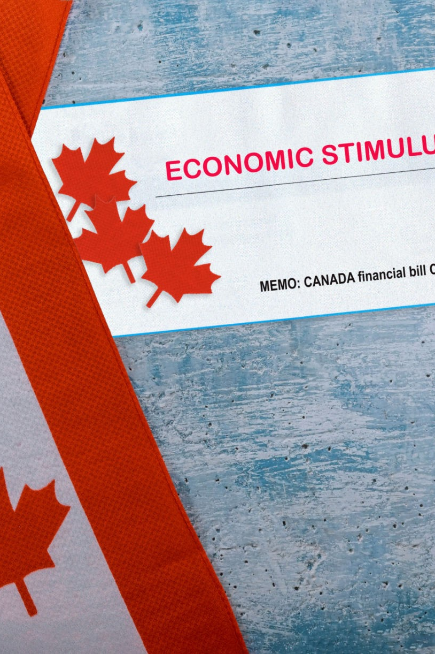
Conclusion
So, in short, Canada also has stuff set up for natural disasters. Municipal first responders handle the initial crisis.Regional governments step in when cities can’t handle it. Sends immediate emergency alerts to cell phones, TV, and radio. Canada normally gets ready after the Natural disaster. They rebuild the communities, and they provide financial aid to families, businesses, and local governments to help them recover from the economic losses.

Slide 13
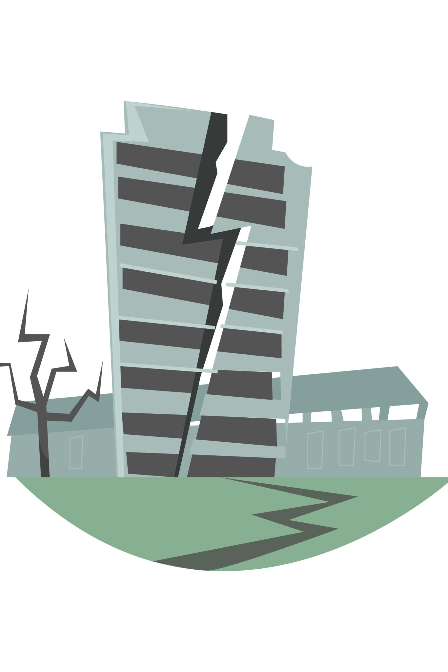
How will Canada handle the “Big one”
Canada must build a financial safety net before a disaster happens, rather than waiting for an earthquake to hit and trying to fix the damage afterward. Emergency planning is another big part of Canada’s response, with planned stuff between local, provincial, and federal governments to handle search and rescue, medical care, and emergency shelters. Public education encourages people to prepare emergency kits and practice safety actions like “Drop, Cover, and Hold On.” Canadian government is planning a financial safety system to help people and insurance companies after a major disaster, like a big earthquake. If the damage is too bad, the governments would have no choice but to help pay for the damage. They would have to spend a lot of money that they were not prepared for, which would reduce the amount of money available in public funds for other needs.

Slide 14
Reflection
Why should Canadians care?
Canadians should care because the Philippines has many natural disasters and has learned how to deal with them. Canada can learn from their experience to improve how it prepares for floods, fires, storms, and earthquakes. Disasters in other countries can still affect Canada through the economy and global support, so it helps to understand and learn from each other. Climate change is a global issue.

Slide 15
SOURCES
California State University, Bakersfield. (Unknown). Culture and Tourism. https://www.csub.edu/pacificrim/countryprospectus/culture.htm
CBC news. (2026). Philippines earthquake leads to landslide, raising death toll to at least 32. https://www.google.com/url?q=https://www.cbc.ca/news/world/philippines-earthquake-9.7226889&sa=D&source=editors&ust=1781285676934450&usg=AOvVaw2V-jT_5NV9Tw712Lo-S_rk
Climate Impacts Tracker Asia. (2024). Climate Change In The Philippines: Causes, Effects and Solutions. https://www.climateimpactstracker.com/climate-change-in-the-philippines-causes-effects-and-solutions/
Government of Canada. (2026). Natural hazard risk assessment. https://www.google.com/url?q=https://issuances-library.senate.gov.ph/legislative-issuance/republic-act-no-12287&sa=D&source=editors&ust=1781285818426497&usg=AOvVaw3n4KgnOZoyl-Y4VDso2dvj
Government of Canada. (2022). Emergency Management Strategy for Canada: Toward a Resilient 2030. https://www.publicsafety.gc.ca/cnt/rsrcs/pblctns/mrgncy-mngmnt-strtgy/index-en.aspx
Government of Canada. (2020). Disaster Assistance Response Team (DART). https://www.canada.ca/en/department-national-defence/services/operations/military-operations/types/dart.html
GOVPH. (unknown). Climate of the Philippines. https://www.google.com/url?q=https://www.pagasa.dost.gov.ph/information/climate-philippines&sa=D&source=editors&ust=1781285018975839&usg=AOvVaw2pvAwWXwSgscNrD1MM2hkb
Jason Clark, National Director, Climate Change Advocacy, IBC. (2024). The Big One: Is Canada Prepared for an Earthquake Catastrophe?. https://www.ibc.ca/news-insights/in-focus/the-big-one-is-canada-prepared-for-an-earthquake-catastrophe-
Macario Lacbawan. (2025). Climate resilience in the Philippines starts with accountability. https://eastasiaforum.org/2025/10/15/climate-resilience-in-the-philippines-starts-with-accountability/
The Climate Reality Project. (2016). How Is Climate Change Affecting the Philippines?. https://www.google.com/url?q=https://www.climaterealityproject.org/blog/how-climate-change-affecting-philippines&sa=D&source=editors&ust=1781285589782308&usg=AOvVaw3HWRNjyE99H8srxHVqzXxq
The World Bank. (2016). Protecting Lives and Property from Disaster Risk in the Philippines. https://www.gfdrr.org/en/feature-story/protecting-lives-and-property-disaster-risk-philippines
Wikipedia. (2026). Regions of the Philippines. https://www.google.com/url?q=https://en.wikipedia.org/wiki/Regions_of_the_Philippines&sa=D&source=editors&ust=1781284671505538&usg=AOvVaw1RZ-fXH_j3qyJ8yrDw6tEK

